Slide 1



Introduction to Workflow Managers and the Persistence1 Service on Alpine
By: Maclean Sherren

Slide 2
What is a workflow manager?
A workflow manager is a program that manages a collection of connected steps to fast track the computational process
They create reproducible and scalable data analysis pipelines

Slide 3
Why are workflow managers important?
Imagine having a workflow with the following steps:
split -> data conversion/configuration -> workflow main function -> workflow outputs
Outside of a workflow manager, some of these above steps may require multiple programs, multiple jobs being run across broken up sample sizes, or a custom script to prepare the data for the main workflow function
A workflow manager covers all these steps in a single script (Nextflow ex: https://www.nextflow.io/basic-pipeline.html)

Slide 4

Workflow Managers supported on Alpine: Nextflow, Snakemake, NF-Core, KinBot
These are the most common workflow managers used on Alpine. Nextflow, Snakemake, and NF-Core are especially utilized by Colorado Anschutz Medical Campus users

Slide 5
What is Persistence1 on Alpine?
Persistence1 is a dedicated service for running long-lived workflow managers that coordinate jobs on Alpine
It exists because of the specific demands of these managers, such as processes that remain active for days or even weeks while monitoring workflow processes and submitting jobs to the cluster
Because of these demands, such jobs are not sustainable at scale in standard Slurm jobs and should not be run on login nodes
Persistence1 provides a dedicated environment where users can run workflow managers and other workflow orchestration tools that require continuous execution while maintaining access to Alpine resources.

Slide 6
Persistence1 Disclaimer (!)
Persistence1 is not intended for running computationally intensive workloads directly, interactive analysis, high-memory applications or replacing Slurm job submissions.
Such analysis and high-memory applications should still be run through the Slurm job scheduler, though the orchestrator itself can be left running on Persistence1
Persistence1 has a wall time of 30 days for an orchestrator to run, but the Slurm jobs submitted by the orchestrator still have a wall time of 7 days!
For more info, see the example in the slides below

Slide 7
Using Persistence1 on Alpine
Users with access to the Persistence1 service can connect with:
ssh persistence1
From there, users will have access to their /home, /projects, /scratch/alpine, and (if available) Peta Library directories
Users can:
Run container-based workflow managers through Apptainer
Use the Miniforge module to create and manage Conda environments that include workflow managers such as nf-core and snakemake
Directly load and use modules for workflow managers such as Nextflow
Persistence1 has 8 cores and 8GB of RAM available.
The wall time is whenever the next planned maintenance is, so at the most, about a month. However; jobs submitted by orchestrators through slurm have a wall time of 7 days

Slide 8
Modules Available (and NOT Available) on Persistence1
Available modules:
miniforge, nextflow versions 22.10.6, 23.04, 24.04.4, and 25.10.2, curc-quota and slurm (for slurm commands, not for running jobs!)
Notable unavailable modules:
Nf-core, snakemake, R, python (all can be installed within a miniforge environment), as well as all other modules available on the compute side of Alpine

Slide 9
Nextflow Set up: Profile
Nextflow requires considerable setup, including a config file:
  https://github.com/kf-cuanschutz/CU-Anschutz-HPC-documentation/blob/main/Workshops/curc_alpine.config
Basic upload instructions:
“cd /projects/$USER/software”
“mkdir nextflow_config”
Upload curc_alpine.config file found in the github link above
Credit to user Thomas Danhorn for creating the original curc_alpine.config file and sharing it with the campus userbase

Slide 10
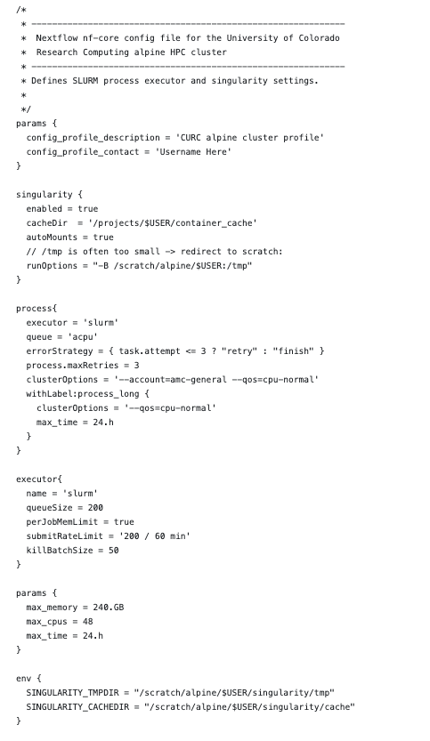
Nextflow: Configuration options within the curc_alpine.config file
Rename “profile contact” to your name
In the process section:
This sets the orchestrator up to use SLURM when running a series of jobs. Note here it selects all the appropriate slurm flags and gives each process a 24 hour wall time.
In the params section:
This section is for the TOTAL orchestrator resources
Max memory should be adjusted according to your needs
Max cpus should be adjusted according to your needs
Max time can be adjusted up to 7 days; this is the wall time for the total jobs run on Slurm via the nextflow orchestrator

Slide 11
Nextflow: Configuration options within the curc_alpine.config file
In the executor section:
The max queue size is 200 jobs on Alpine at a time
The submit rate limit can be adjusted depending on expected wall time for your processes; a good maximum would be 200 / 60 min
Nextflow uses a container environment to run. The default options should be satisfactory, unless using a customized container

Slide 12
Nextflow pipeline: 3 options to run
There are two effective ways to run a Nextflow pipeline on Alpine:
Run from peristence1, a service set up specifically for workflow managers like Nextflow. This is the recommended method
Run from a Slurm script with the sbatch command, lauched from a login node. Because of the limitations on compute, such as wall time, this method is not recommended for long jobs
  Note: if running on slurm, you will need to create a slurm script: https://curc.readthedocs.io/en/latest/running-jobs/batch-jobs.html

Slide 13
A Quick Slide About Tmux
How to close a tmux session but leave it running:
“Ctrl + b”, followed by “d”. This “detaches” the session
How to check active tmux sessions:
“tmux ls”
How to enter a running tmux session:
“tmux attach -t session_name”
How to cancel a tmux session:
“tmux kill-session -t session_name”
How to kill a session you are inside:
“Ctrol + b” followed by “kill-session”

Slide 14
Nextflow: Persistence1 example
First, you will need to get onto the Persistence1 hardware. If you do not have access, you can request access by emailing our team at hpcsupport@cuanschutz.edu
The following commands can be run from a BASH script (ex.: https://github.com/kf-cuanschutz/CU-Anschutz-HPC-documentation/blob/main/Workshops/bash_nextflow_examplescript.sh)
OR from a terminal window:
Notes: tmux is for longer, detached sessions when you run your actual workflow. Tmux sessions can run for weeks. Containers (apptainer, singularity) work on persistence1 with default version 1.4.3-1
# OPTIONAL: tmux; for long running workflow sessions you can come back to:
tmux new –s my_session # -s flag names your session to come back to
ssh persistence1
module load nextflow
cd /projects/$USER/software/nextflow_config
# This is the recommended location to store your config files

Slide 15
Nextflow: Persistence1 example
#There are export commands you can include in your bash script or simply embed in your config file. For example:
export $pipelinepath = /path/to/your/pipeline
export $samplefile = /path/to/input/sample/file
# Once you have finished exporting any paths and commands, you are ready for your nextflow command:
nextflow run bash_run_sarek.sh -ansi-log false --input "$samplefile"--outdir /projects/$USER/software/nextflow_config --tools mutect2,strelka,tiddit,freebayes,vep,snpeff -resume -c curc_alpine.config
Note your nextflow command will BE DIFFERENT from the example above.
You will need to configure your own paths, container paths, tools, inputs, outputs, etc. This can be done either within the nextflow command, or in the config file
The last flag passes the config file, “curc_alpine.config”, which we demo-ed in previous slides. You will also need to customize your config file to fit your resource needs

Slide 16
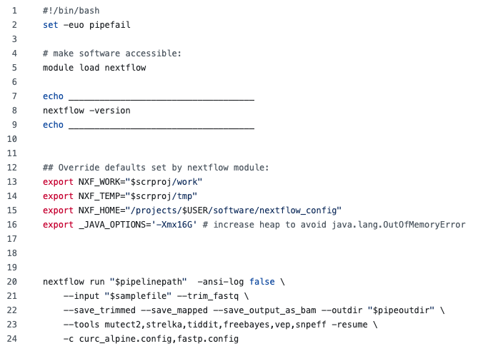
Nextflow: persistence1 example script
This example script can be found here: https://github.com/kf-cuanschutz/CU-Anschutz-HPC-documentation/blob/main/Workshops/bash_nextflow_examplescript.sh
When on Persistence1, this script can be run after adjustments are made. To run this outside of persistence1 from a login node, additional #SBATCH commands are required to run: https://curc.readthedocs.io/en/latest/running-jobs/batch-jobs.html
You will need to adjust the “nextflow run” command extensively to match your pipeline’s specific needs

Slide 17
Nf-core set up on persistence1
Tmux is optional to start
The final command launches the nf-core interface, where you can install modules, pipelines, or run test datasets.
Note that the nf-core install also installs nextflow, so to run a nf-core pipeline, a command such as “nextflow run nf-core \ <nextflow pipeline flags here>” will work.
Once nf-core is installed, you can also launch a script within persistence1 (see slides12-14)
ssh persistence1
module load miniforge
conda create --name nf-core-env
conda activate nf-core_env
conda install bioconda::nf-core
nf-core interface

Slide 18
Snakemake installation on persistence1
*Tmux session is always a possibility before “ssh persistence1”
ssh persistence1
module load miniforge
conda create -n snakemake_env
conda activate snakemake_env
conda install -c bioconda snakemake
#Test
snakemake --help

Slide 19
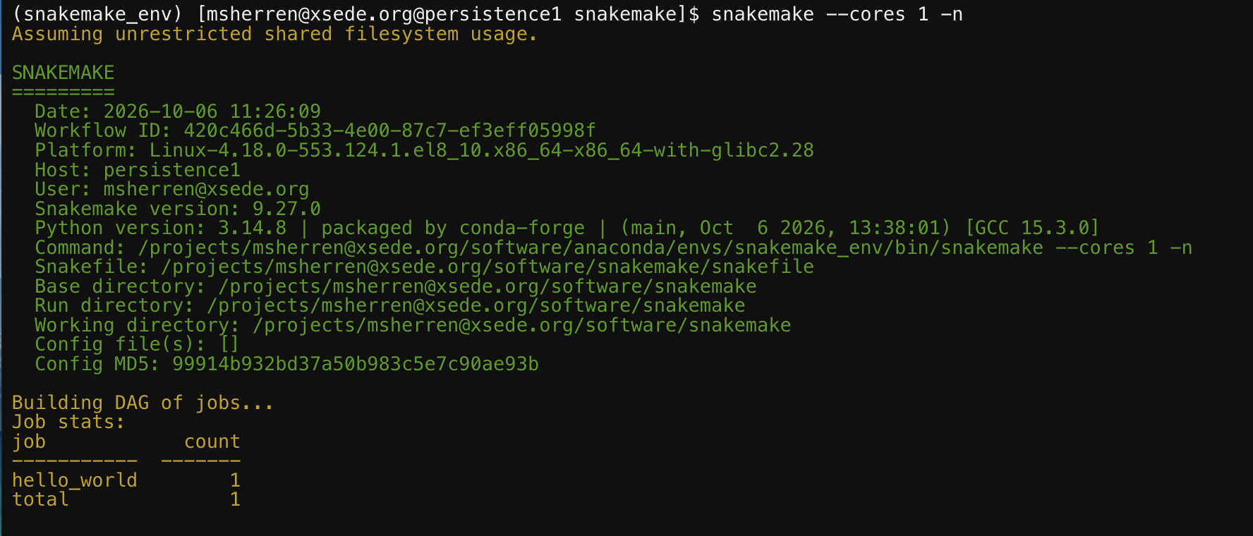
Snakemake basic example on persistence1:
Snakemake command run with 1 core
Input file is “snakefile”
Output file “hello_world”
The following can also be added to a bash script, requesting compute resources, and run in a tmux window:
This will ultimately run the snakemake workflow out of your current working directory with 4 cores on persistence1
module load miniforge
conda activate snakemake_env
snakemake --cores 4

Slide 20
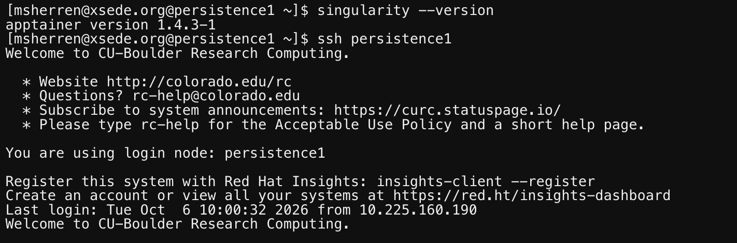
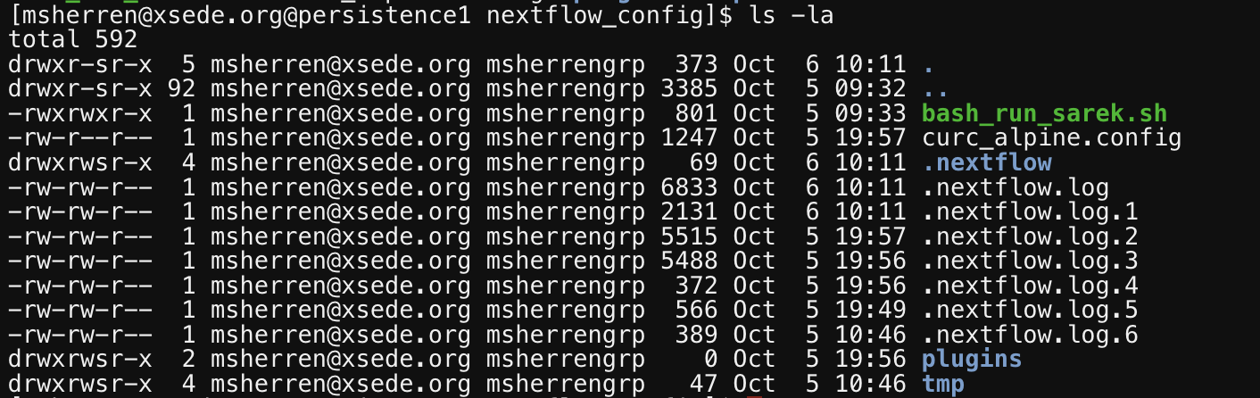
Troubleshooting on persistence1
Persistence1 acts in some ways as its own login node. When a pipeline is launched from persistence1, it utilizes slurm resources and generates JobIDs from each individual process.
You can then troubleshoot the jobs in a traditional manner with commands such as “seff”, “squeue”, “sacct”. You can read more about troubleshooting jobs on Alpine here:
https://github.com/kf-cuanschutz/CU-Anschutz-HPC-documentation/blob/main/Workshops/Alpine_best_practices_workshop_03262025.pdf.
Another way to troubleshoot is with the output directory. In the nextflow example, the output directory was set as “/projects/$USER/software/nextflow_config”
  When a nextflow pipeline fails, a “.nextflow.log.[#]” file is generated in the output directory. You can see these hidden files with the command “ls –la”:

Slide 21
Questions?

Slide 22
THANK YOU
Feel free to contact us at HPCSupport@cuanschutz.edu for access to persistence1 and any questions related to workflow managers on persistence1

